Slide 1
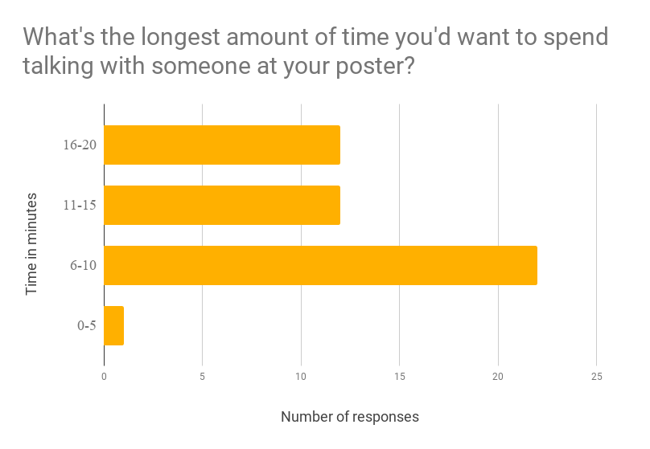
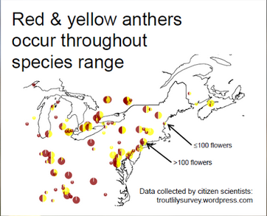
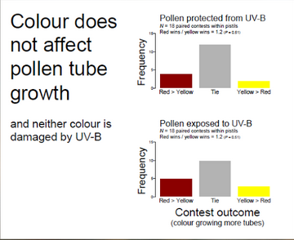
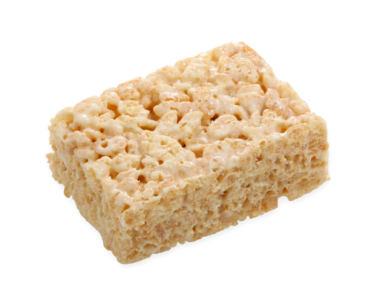
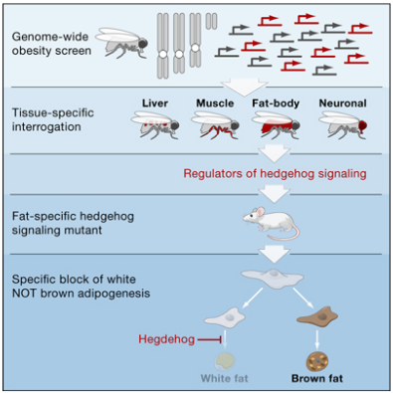
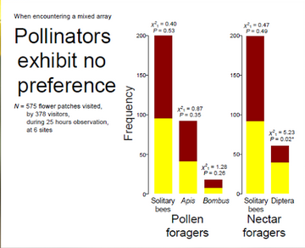
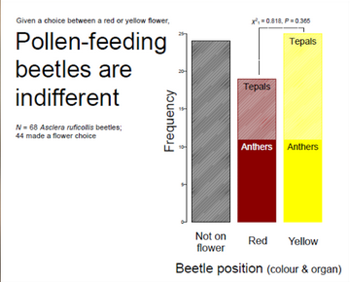
The main question goes here, translated into plain English. Strive for simple and clear.
Highlights
A well-crafted message is more important than any layout design.
Visual design strategies can be employed to incorporate lessons from Morrison’s Better Poster without sacrificing valuable poster space.
All academic disciplines can help us approach the world with curiosity.
Derek B. Crowe¹, Melanie Rogala³, S.P. Margolis^{1,2}, Luke H. Shaw^{1,3}, David Sanchez², Sarah Rutherford², Amber V. Odhner²
Background
Make the case for why this is an interesting question that is worth answering. What is the broader context and why should the reader should care? Feel free to add graphics if they get the point across faster.
Clearly state how to interpret the group of visualizations below and optionally how it relates to the broader findings.
Clearly state how to interpret the group of visualizations below and optionally how it relates to the broader findings.
Data
Briefly describe the data that you are working with as well as how you transformed it to answer your stated question. Use a flow-chart if possible.
State the main take-away from this graphic succinctly.
11"
10/20
8.5"
State the main take-away from this graphic succinctly.
State the main take-away from this graphic succinctly. Let your visualization speak for itself, don’t add too much text.
Model
Quickly deliberate the reasoning behind the model that you chose. What decision-making went into this process? Consider mentioned the performance metrics that you prioritized in this case. What are the limitations of this approach?
The main finding goes here, translated into plain English. Strive for simple and clear - save the nuance for the section to the right.
Nuance
Let your title speak for itself; don’t bold keywords or phrases. Use the white borders as modular dividers to facilitate breathing room for your text and figures. Don’t be afraid of leaving open space. Play with the columns based on your figure aspect ratio.
Notes:
Notes:
In Powerpoint, click View > Guides
Keep text within gutter guides.
Author list: Don’t split names onto two lines (e.g., “Jimmy [break] Smith”). If that happens, use a new line, unless you need the space. Bold the first names of anybody who’s presenting in person.
Intro/methods/result: Do not drop below font size 28, but if you have extra space, jack up the font size until the space is full.
Do not use color in the sidebars except in graphs/figures. It’ll pull attention from the center and slow interpretation for passersby.

Slide 2
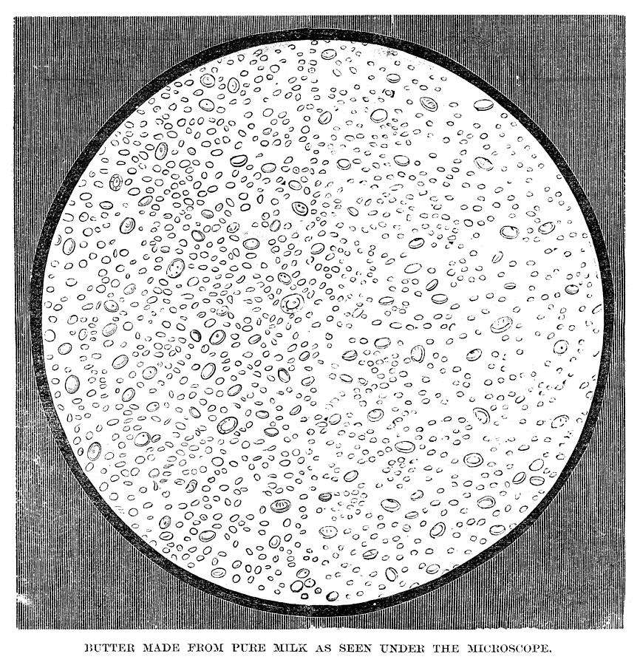
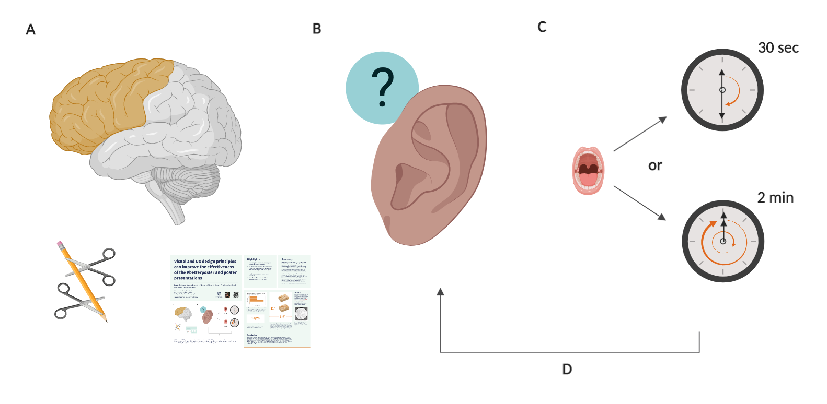
The main question goes here, translated into plain English. Strive for simple and clear.
Highlights
A well-crafted message is more important than any layout design.
Visual design strategies can be employed to incorporate lessons from Morrison’s Better Poster without sacrificing valuable poster space.
All academic disciplines can help us approach the world with curiosity.
Derek B. Crowe¹, Melanie Rogala³, S.P. Margolis^{1,2}, Luke H. Shaw^{1,3}, David Sanchez², Sarah Rutherford², Amber V. Odhner²
Background
Make the case for why this is an interesting question that is worth answering. What is the broader context and why should the reader should care? Feel free to add graphics if they get the point across faster.
Model
Quickly deliberate the reasoning behind the model that you chose. What decision-making went into this process? Consider mentioned the performance metrics that you prioritized in this case.
Clearly state how to interpret the group of visualizations below and how it relates to the broader findings
State the main take-away from this.
Data
Briefly describe the data that you are working with as well as how you transformed it to answer your stated question. Use a flow-chart if possible, like below.
10/20
The main finding goes here, translated into plain English. Strive for simple and clear - save the nuance for below.
Nuance
Let your title speak for itself; don’t bold keywords or phrases. Use the white borders as modular dividers to facilitate breathing room for your text and figures. Don’t be afraid of leaving open space. Play with the columns based on your figure aspect ratio.
Notes:
Notes:
In Powerpoint, click View > Guides
Keep text within gutter guides.
Author list: Don’t split names onto two lines (e.g., “Jimmy [break] Smith”). If that happens, use a new line, unless you need the space. Bold the first names of anybody who’s presenting in person.
Intro/methods/result: Do not drop below font size 28, but if you have extra space, jack up the font size until the space is full.
Do not use color in the sidebars except in graphs/figures. It’ll pull attention from the center and slow interpretation for passersby.

